Slide 1
TOPIC NAME - Forecasting Stock Prices using historical data and market indicator

Slide 2
Introduction:
Stock market forecasting is a critical area of interest for investors, analysts, and financial professionals alike, aiming to predict future movements in stock prices based on historical data and market indicators. In this mini-project, we explore the application of R programming to forecast stock prices using historical data of Apple Inc. (AAPL) sourced from Yahoo Finance. Leveraging the power of quantitative analysis and time series forecasting techniques, we aim to develop a model that provides insights into potential future trends in AAPL stock prices.
To build this mini project we have to followed the below steps:
Step 1: Importing Required Packages:
The code begins by importing necessary R packages for data manipulation, visualization, and time series forecasting. These packages include quantmod, tseries, forecast, and zoo.
Step 2: Importing Dataset from Finance Websites:
The getSymbols() function from the quantmod package is used to fetch historical stock price data for the specified symbol (in this case, "AAPL" for Apple Inc.) from a finance website (default is Yahoo Finance). The data is retrieved for the period from January 1, 2019, to January 1, 2021.
Step 3: Visualization of Stock Data:

Slide 3
After importing the data, the code visualizes the stock price data using the chartSeries() function from the quantmod package. Bollinger Bands are added to the chart using addBBands() to visualize volatility.
Step 4: Data Preparation:
The code assigns different columns of the dataset to separate variables, such as opening, high, low, closing, volume, and adjusted prices. These variables will be used for analysis and forecasting.
Step 5: Time Series Analysis:
The code then performs time series analysis to identify patterns and correlations in the data. It calculates the Autocorrelation Function (ACF) and Partial Autocorrelation Function (PACF) plots for the differenced series of adjusted prices. Additionally, it conducts the Augmented Dickey-Fuller (ADF) test to test for stationarity of the time series data.
Step 6: Prediction of Returns:
Next, the code calculates the returns of the stock prices using the logarithmic difference of adjusted prices. It splits the data into training and testing sets, fits an ARIMA (AutoRegressive Integrated Moving Average) model to the training data, and makes predictions for the testing set.
Step 7: Forecasting Predicted Results:
Finally, the code uses the fitted ARIMA model to forecast future stock returns. It generates forecasts for a specified horizon (in this case, 15 days) using the forecast() function from the forecast package and plots the forecasted results.

Slide 4
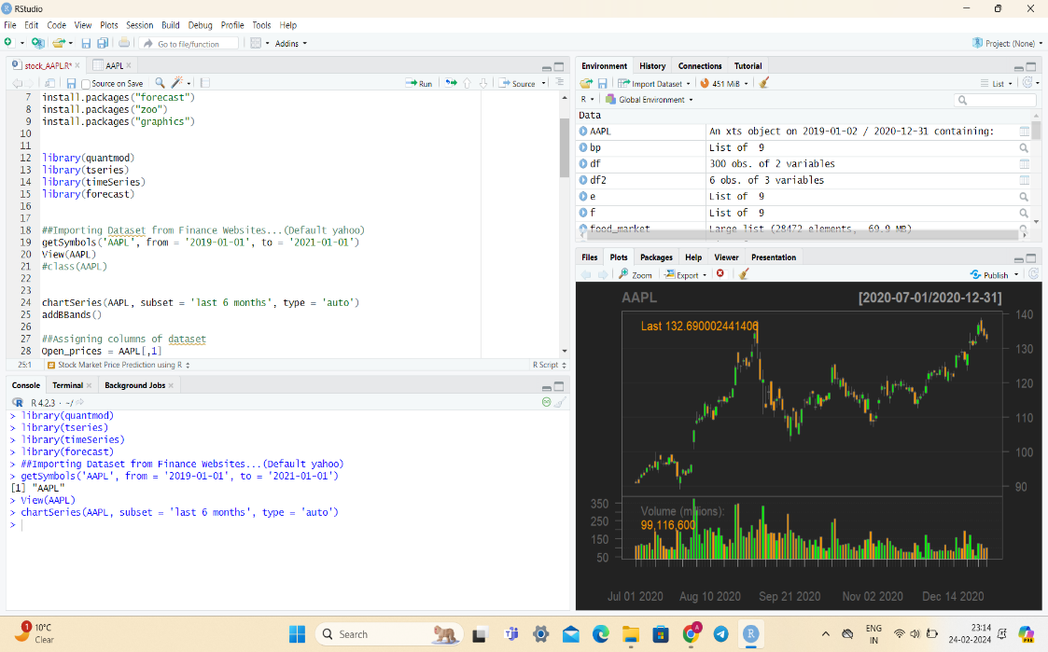
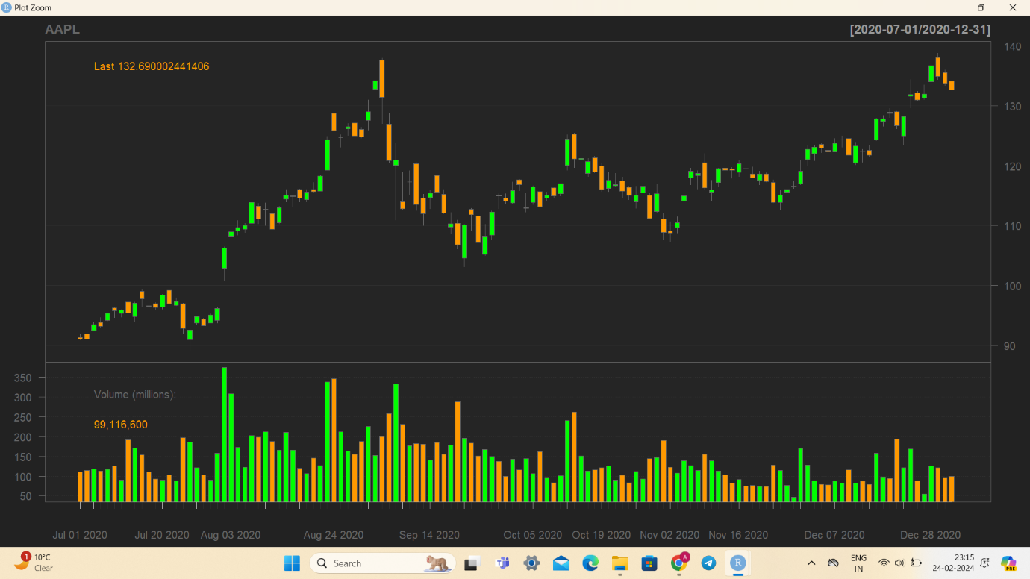
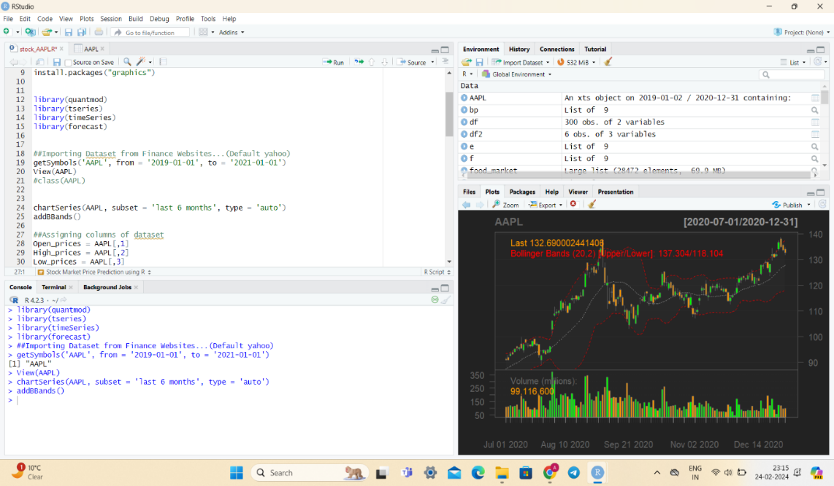
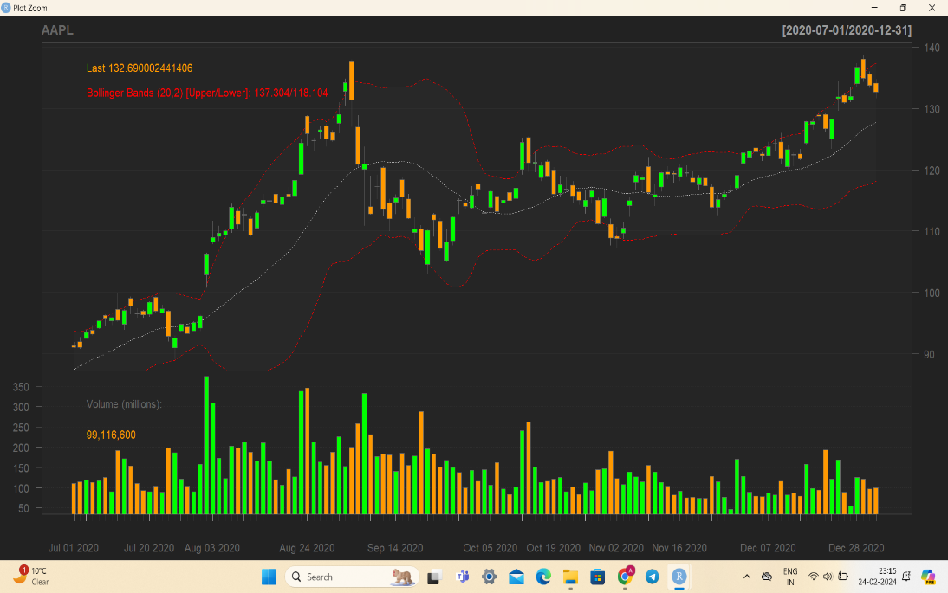
Result/Output

Slide 5
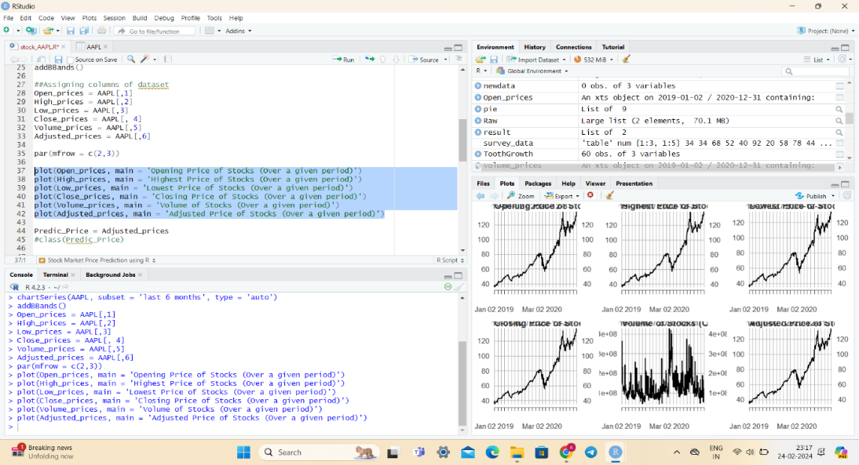
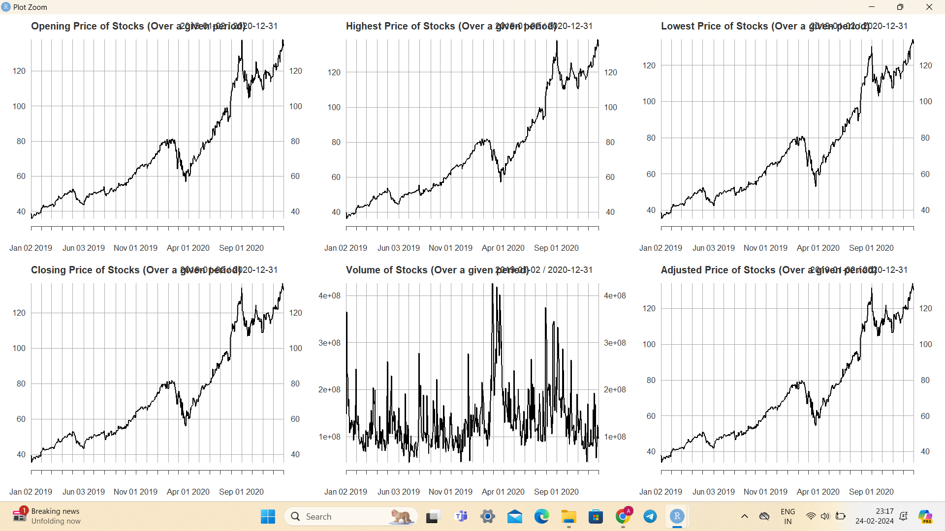

Slide 6
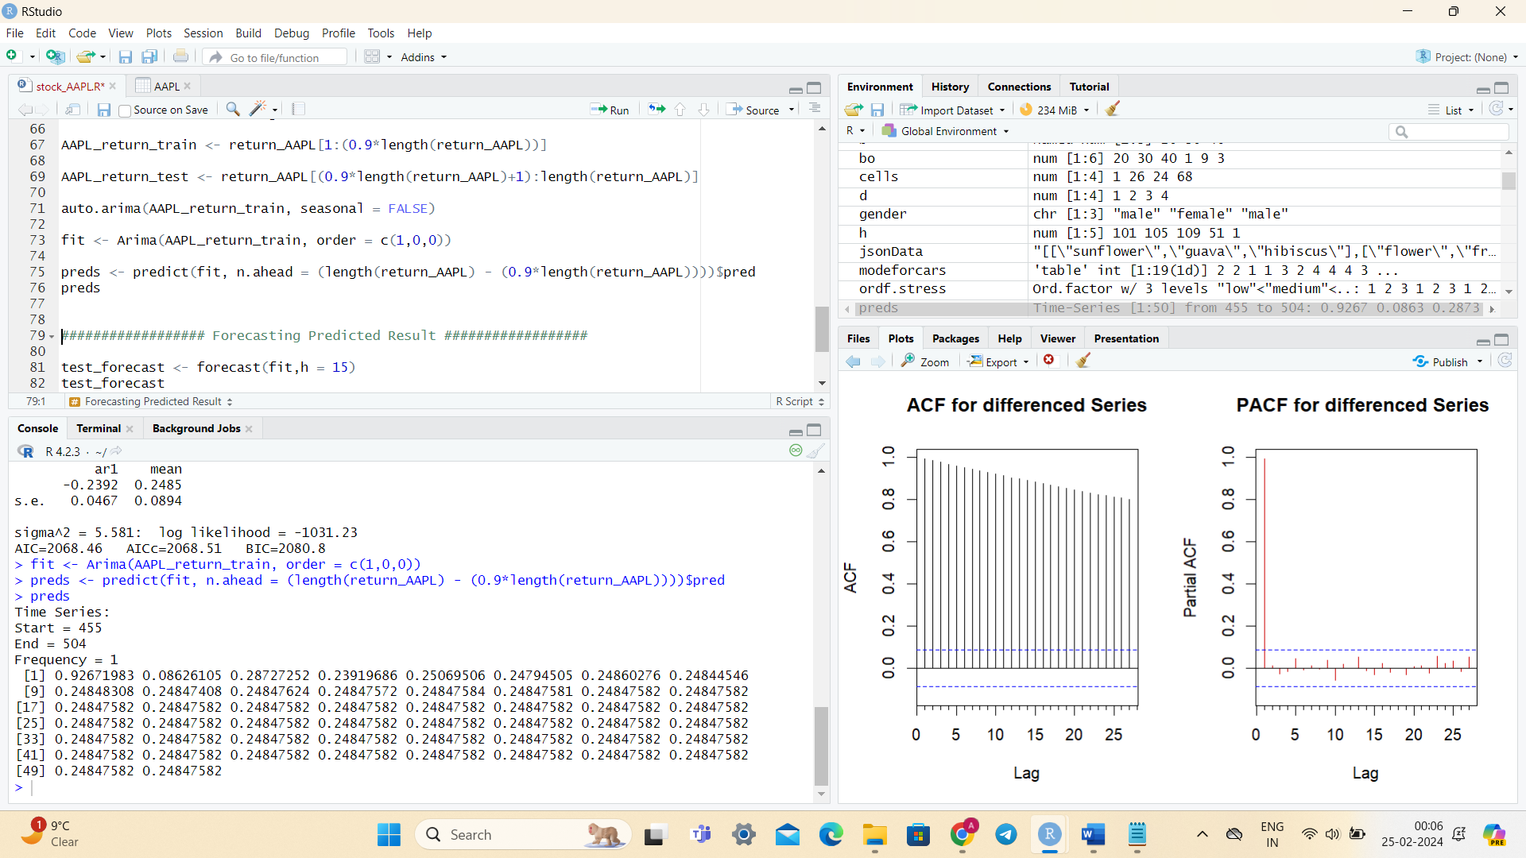
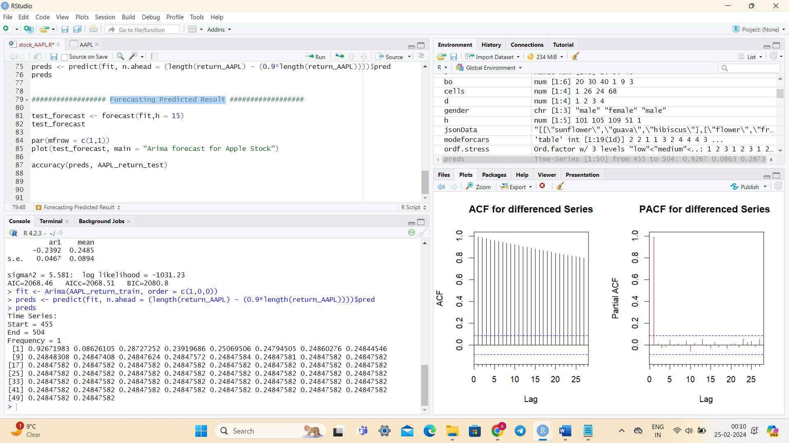
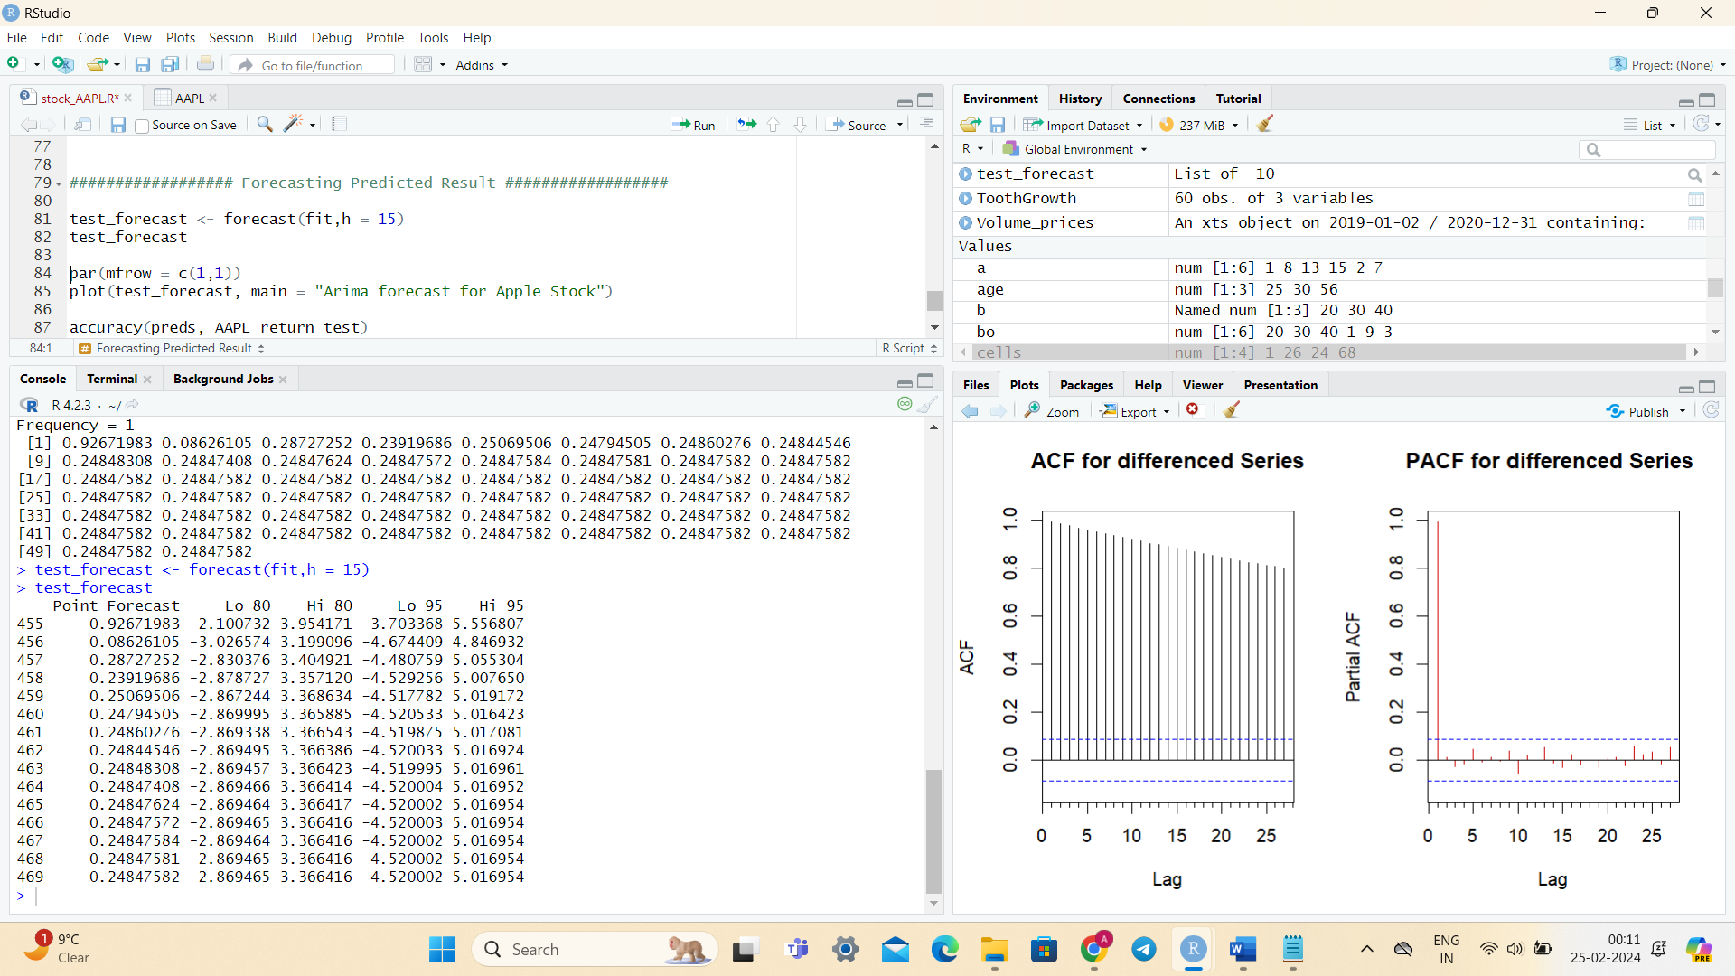

Prediction of Return:
Forecasting Predicted Result

Slide 7
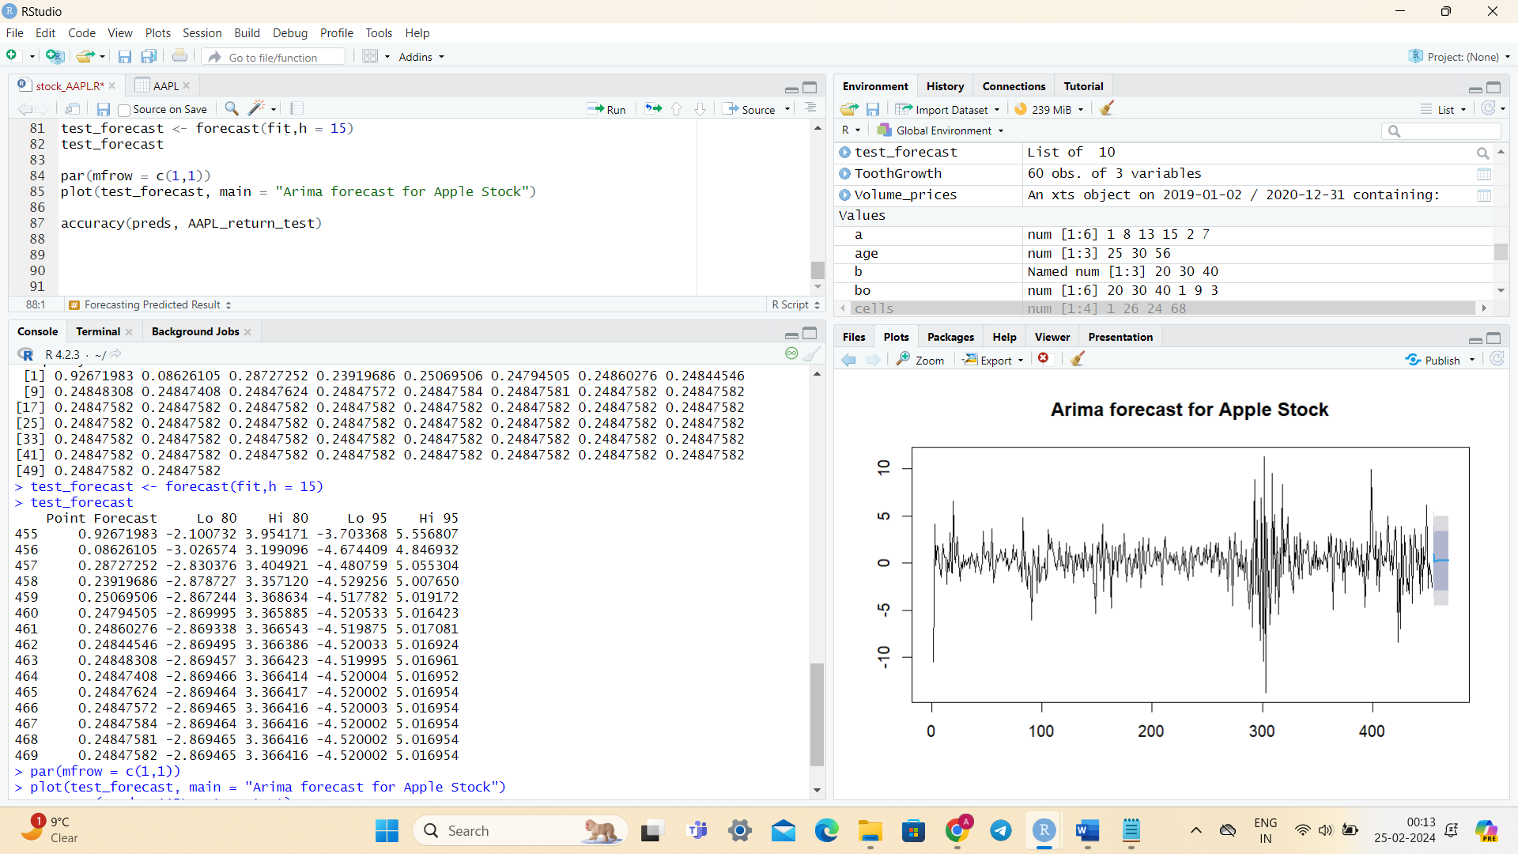
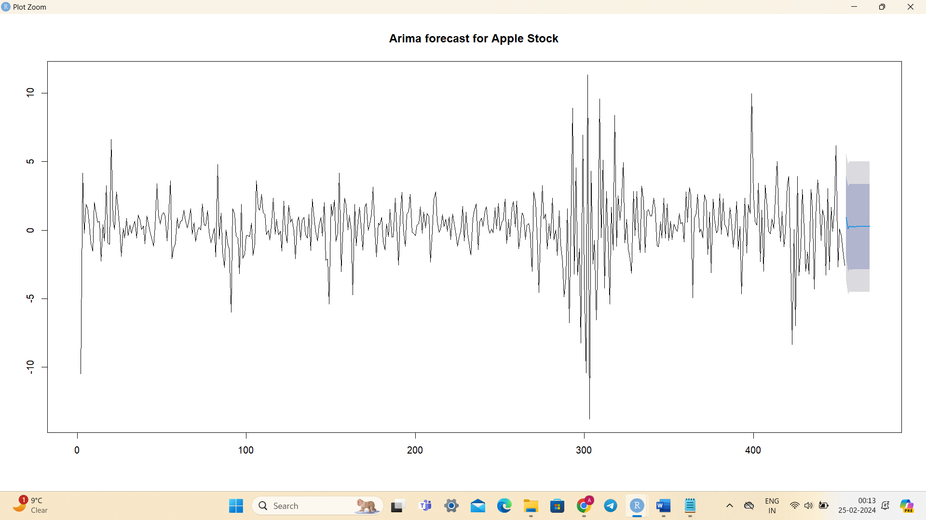
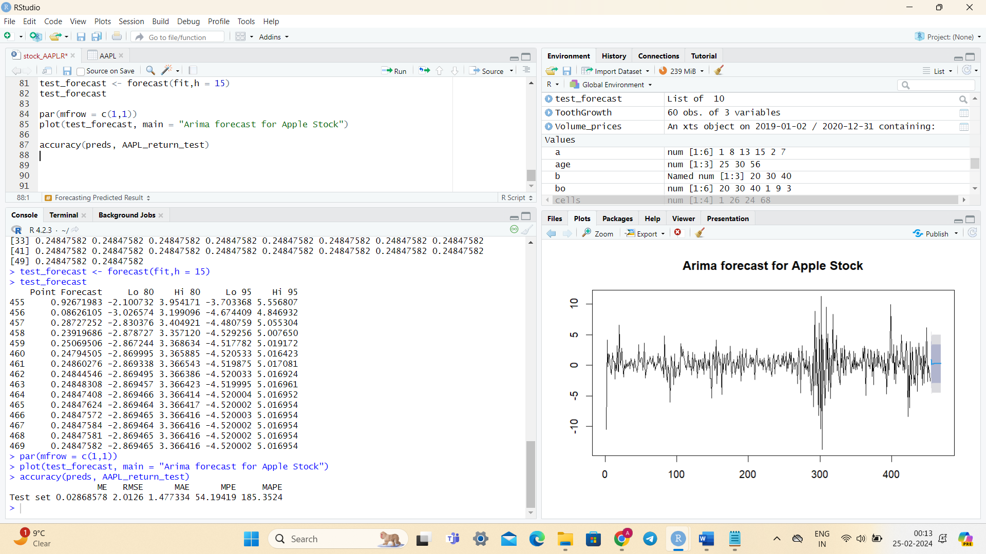
Accuracy of model

Slide 8
Conclusion:
In this mini-project, we have explored the process of forecasting stock prices using historical data and market indicators in R programming. By leveraging the capabilities of quantitative analysis and time series forecasting techniques, we have gained insights into the potential future trends of Apple Inc. (AAPL) stock prices.
Through the utilization of the quantmod package, we retrieved historical stock price data from Yahoo Finance and visualized the trends using Bollinger Bands, allowing us to observe patterns and volatility in the data. Subsequently, by conducting time series analysis, we identified correlations and assessed the stationarity of the time series data.
Furthermore, we calculated stock returns and built an AutoRegressive Integrated Moving Average (ARIMA) model to forecast future stock prices. By splitting the data into training and testing sets, we evaluated the performance of our model and generated forecasts for future price movements.
While this mini-project provides a foundational understanding of stock market forecasting in R programming, it is essential to recognize the limitations and challenges associated with such predictions. Factors such as market sentiment, economic indicators, and unforeseen events can significantly impact stock prices, necessitating continuous refinement and validation of forecasting models.

Slide 9
THANK YOU

